Slide 1

Object Selection
_______________________
_______________________
Student:
Nguyen Van Khoi
Tran Hoang Nam
Supervisor:
MSc. Tu Trung Hieu

Slide 2
Introduction
Literature review
Problem statement
Interactive graph cut segmentation
Silent Lazy Snapping solution
Experimental results
Future direction
Question and answer

Slide 3
Image selection
An image is a set of sub-images that sometimes referred to as regions-of-interest, ROIs, or simply regions.
One of the problem in image processing is image selection – how to cut out or select an area for later specific image processing operations.

Slide 4
Interactive single-image segmentation
Interactive single-image segmentation (image cutout or foreground/background separation), one of the typical case in region selection problem, is to select the object (e.g. human, flower) from the background that based on samples provided by the user.

Slide 5
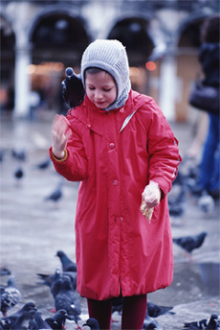
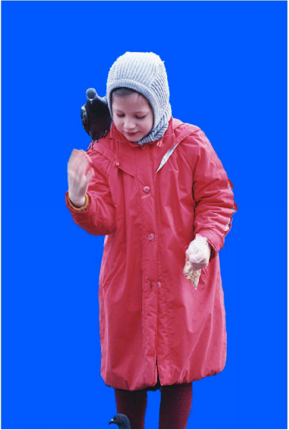
Image segmentation from Lazy Snapping paper

Slide 6
Introduction
Literature review
Problem statement
Interactive graph cut segmentation
Silent Lazy Snapping solution
Experimental results
Future direction
Question and answer

Slide 7
Graph cut for Interactive Segmentation
Based on the works of Greig et al., Exact maximum a posteriori estimation for binary images, 1989.
Region-based method
Constructing graph from image at pixel-detail level
Energy function combine both region and boundary properties

Slide 8
Lazy Snapping (Microsoft Research Asia - 2004)
Goal: separate object from background
First step: foreground/background selection
Sample are given by users in each part of image (draw strokes)
Solve minimum cut problem on segment level
Second step: boundary correction by Overriding brush or Direct vertex editing
User provides some strokes on incorrect parts of object
Solve minimum cut problem on pixel level

Slide 9
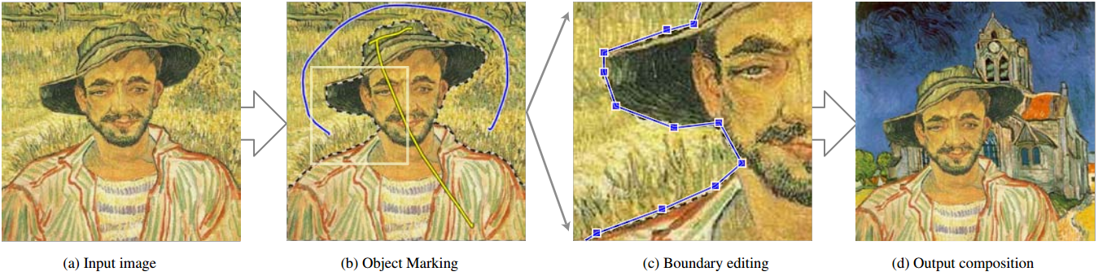
Lazy Snapping samples

Slide 10
GrabCut (Microsoft Research Cambridge – UK – 2004)
Goal: separate object from background
First step: foreground/background selection
Sample are given by users in each part of image (lasso, rectangle bounding box)
Solve minimum cut problem on segment level
Second step: boundary correction by border matting
User provides some strokes on incorrect parts of object
Solve minimum cut problem on pixel level

Slide 11
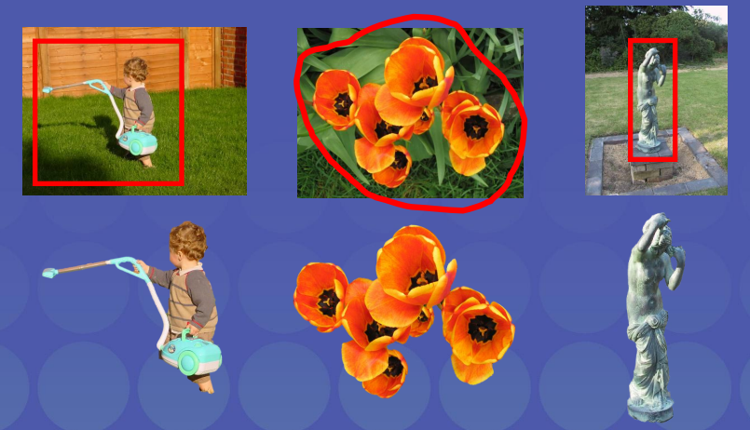
GrabCut samples

Slide 12
Introduction
Literature review
Problem statement
Interactive graph cut segmentation
Silent Lazy Snapping solution
Experimental results
Future direction
Question and answer

Slide 13
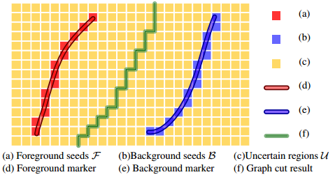
Problem statement
Suppose we have an input image N and some sets of pixels:
Foreground set : set of all pixels that are sample for the object.
Background set : set of all pixels that are sample for the background.
Uncertain set : set of all pixels that are not in the both fore/background set.
How to figure out all pixels belong to the object in the image and separate them from the background?

Slide 14
Binary images: foreground, background
A binary image is an image in which each pixel belongs to one of only two possible discrete logical value: 1 or 0. In out problem:
The logical value 1 is known as “object”.
The logical value 0 is known as “not object”.
We define the set of pixels which logical value is 1/0 as the temp foreground/background pixel.

Slide 15
Binary labelling problem
For all image pixels, we need to assign a unique label
If a pixel is in the foreground/background set, the label of it is 1/0.
If a pixel is not in the foreground and background set, the temporary label of it is “uncertain”.
How to find a way to label all pixels in the image so that all pixels belong to object we want to select have same label, and so do to the another pixel?

Slide 16
Binary labelling problem - Constraint
Data constraint
Prior constraint
If a pixel has it colors similar to at least one pixel belong to foreground seeds, it is more likely to get foreground label, and so do with background seeds.
Pixels that belong to the object tend to group together, and so do with pixels that belong to background.

Slide 17
Binary labeling problem
Let be the value of pixel p, so that:

Slide 18
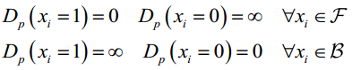
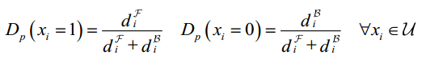
Binary labeling problem
We model data constraint by using Data Penalty Function
To figure out how image satisfy the data constraint, we sum up all pixel penalty function:

Slide 19
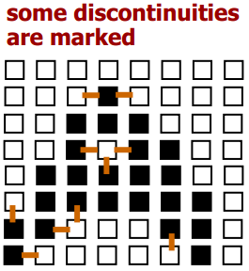
Prior constraint Discontinuity definition
Pixel p and q exist a discontinuity if . By that, each pixel belong to the object boundary have some discontinuities pixels around.

Slide 20
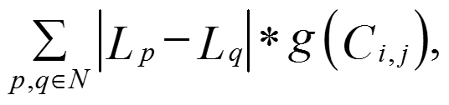
Binary labeling problem
We model the prior constraint as a function of the color gradient for all discontinuities:
Where:
is the L2-Norm of RGB color difference between two pixels p and q.

Slide 21
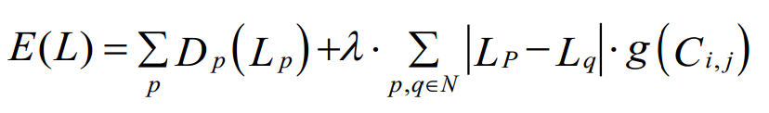
Binary labelling problem
Minimize the energy function (Greig et al., 1989)
Where know as a balancing parameter between data constraint and the prior constraint:
The larger lambda, the less discontinuities in the optimal labeling L.
The smaller lambda, the more optimal labeling L.

Slide 22
Introduction
Literature review
Problem statement
Interactive graph cut segmentation
Silent Lazy Snapping solution
Experimental results
Future direction
Question and answer

Slide 23
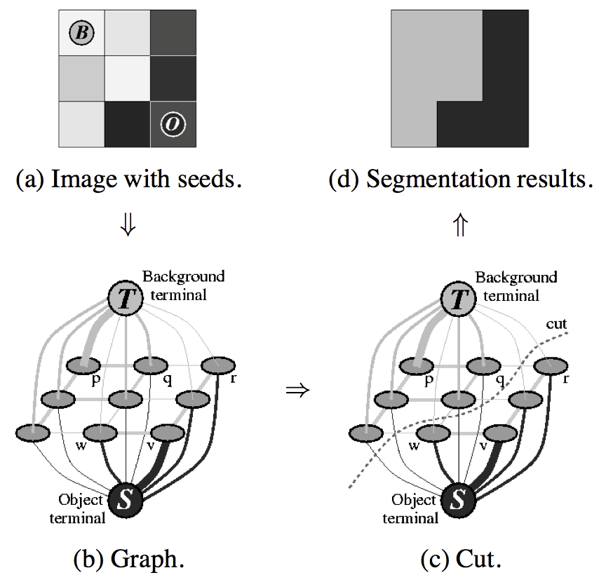
Graph cut construction
A simple segmentation example for a 3x3 image.

Slide 24
Energy function

Slide 25
Energy function (cont.)

Slide 26
Detailed implementation
Negative log-likelihood of intensity for regional term
Ad hoc function for boundary term
Max-flow algorithm provided by Boykov and Kolgomorov (2001)

Slide 27
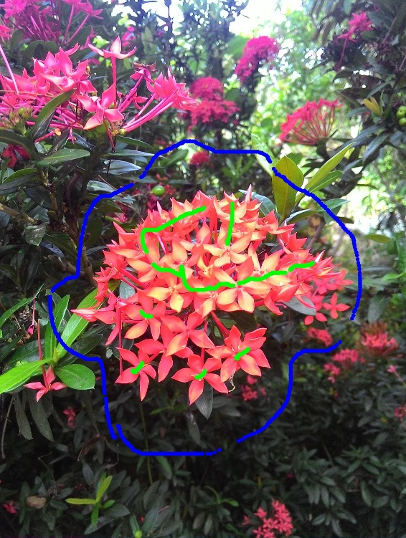

Sample result and comment

Slide 28
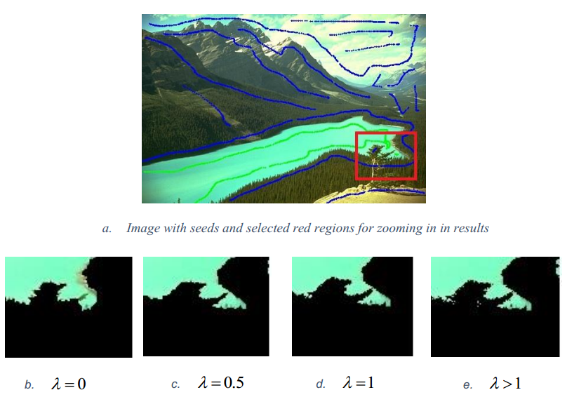
Sample result and comment (cont.)

Slide 29
Introduction
Literature review
Problem statement
Interactive graph cut segmentation
Silent Lazy Snapping solution
Experimental results
Future direction
Question and answer

Slide 30
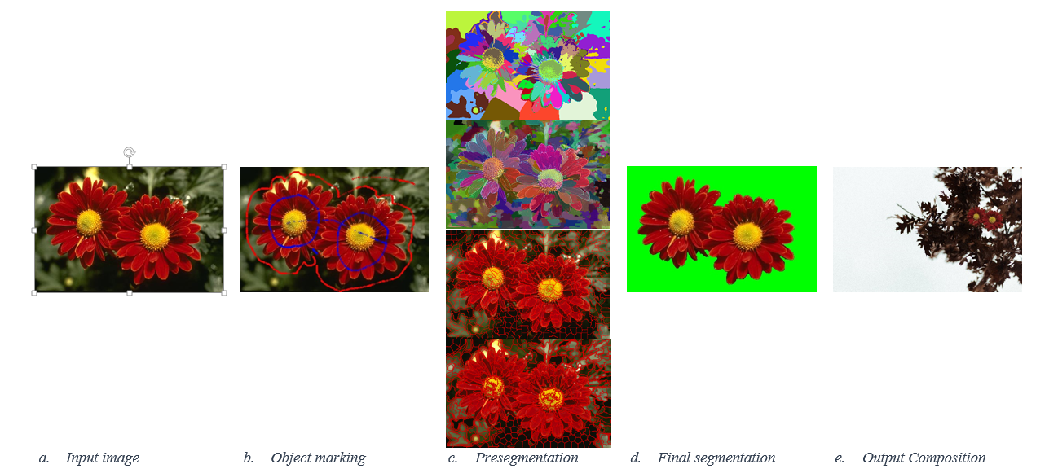
Silent Lazy Snapping model

Slide 31
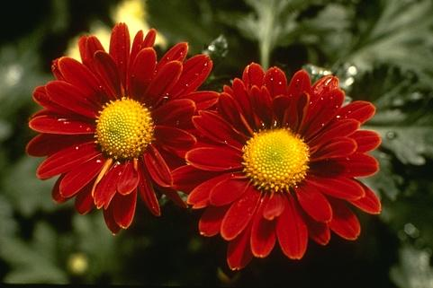
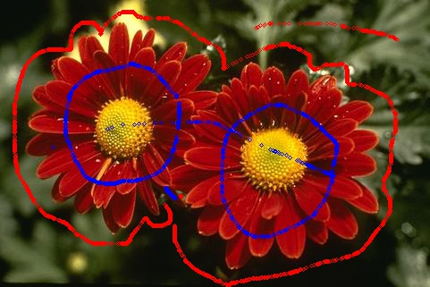
Step 1: Sample definition

Slide 32
Sample definition step
User action:
Visualize examples by drawing strokes/points in input image.

Slide 33
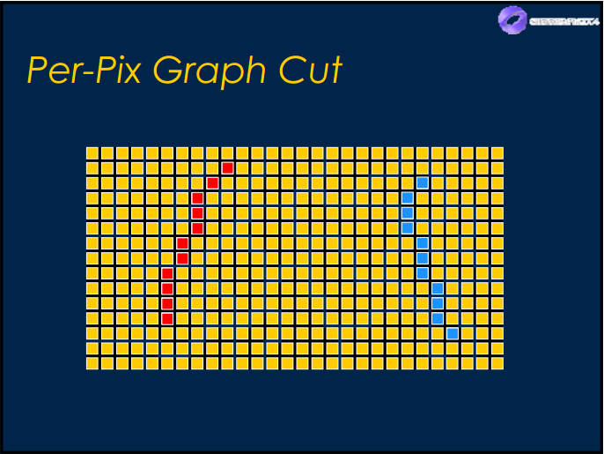
Sample definition step
Sample definition in pixel level:
Blue color: pixel belongs to foreground/object.
Red color: pixel belongs to background.

Slide 34

Step 2: Pre-segmentation by SEEDs algorithm

Slide 35
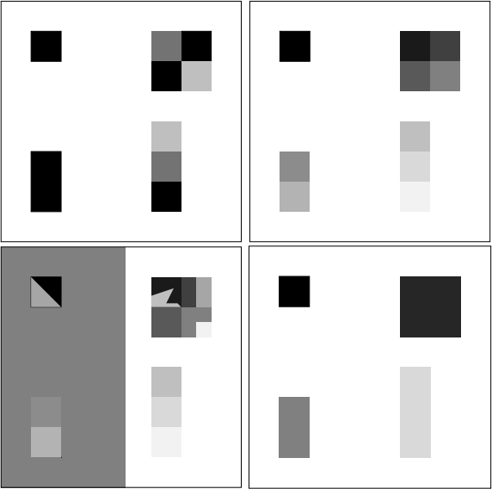
Over-segmentation: pixels belong to same object are classified as belonging to different segments. A single object may be represented by two or more segments.

Slide 36
Under-segmentation: pixels belong to different objects are classified as belonging to the same object. A single segment may contain several objects.

Slide 37

Pre-segmentation step K-means method (4124 segments)
Cannot control the number of segments.
Over-segmentation problem.
Easy to implement, but require time and memory.

Slide 38
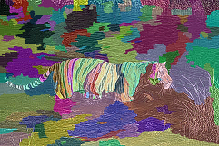
Pre-segmentation step Watershed method (212 segments)
Cannot control the number of segments.
Under-segmentation problem.
Unstable because result depends on threshold value.

Slide 39
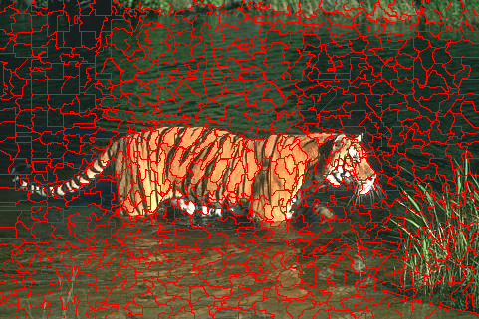
Pre-segmentation step SEEDs – Super pixel (800 segments)
Can control the number of segments.
Depend on the number of iteration.
Under-fitting boundary problem.

Slide 40
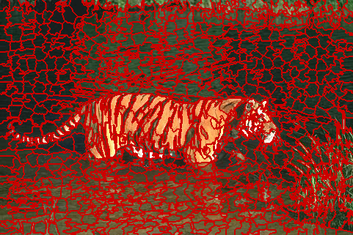
Pre-segmentation step SEEDs – Revised Mean Pixel (800 segments)
Can control the number of segments.
Depend on the number of iteration.
Stable, usable result.

Slide 41
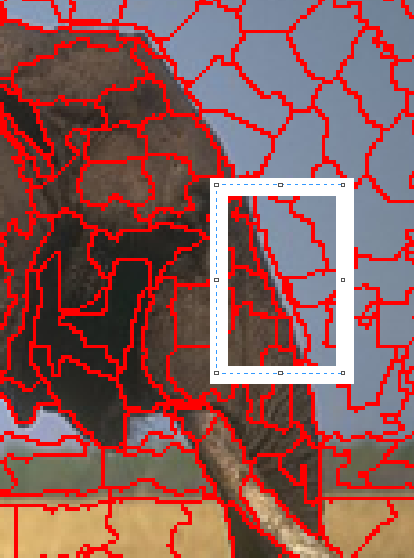
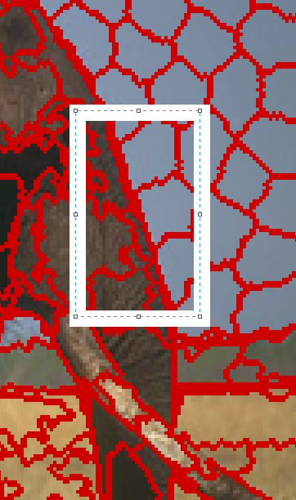
Comparison between SEEDs Super Pixel and SEEDs Revised Mean Pixel
SEEDs Super Pixel
SEEDs Revised Mean Pixel

Slide 42
Why SEEDs Revised Mean Pixels?
Can control the number of segments.
Can control the number of iteration.
Avoid over/under segmentation problem.
Avoid under-fitting boundary problem.
Linear complexity: O(5*N) (N – number of pixel in the original image)

Slide 43
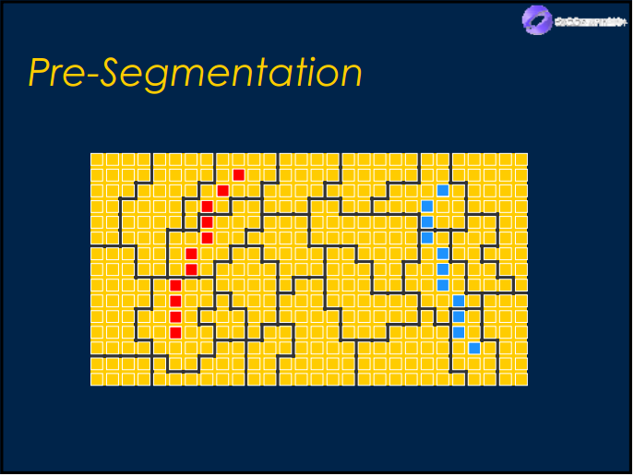
Pre-segmentation step
Segments combine with sample definition in pixel level:
Blue color: pixel belongs to foreground/object.
Red color: pixel belongs to background.

Slide 44
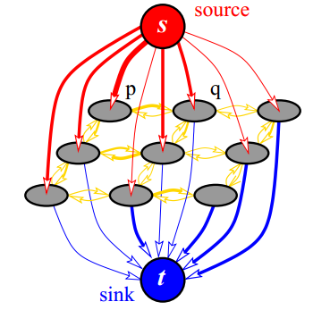
Step 3: Graph initialization

Slide 45
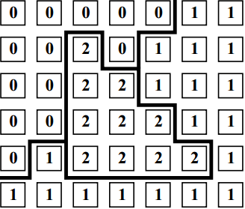
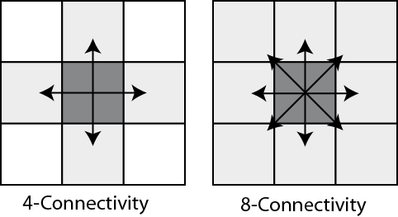
Network properties
Network G = (V, E)
V = {source, sink, segments}
|V| = number of segments + 2
I(u) = mean value of segment u
E = {t-link, n-link}
If pixel p with label L[p] is a neighbor of pixel q with label L[q] and L[p] <> L[q], so p and q are neighbor in the network.
If pixel p belongs to foreground sample, we mark vertex L[p] connect to source.
If pixel q belongs to background sample, we mark vertex L[q] connect to sink.

Slide 46
T-link cost
Use K-means method to cluster the color of foreground seeds and background seeds .
The mean colors of each set are denote as and .
Each node has its color .

Slide 47
N-link cost
is the L2-Norm of RGB color difference between two pixels p and q.
More detailed, we use Euclidean distance to compute .

Slide 48
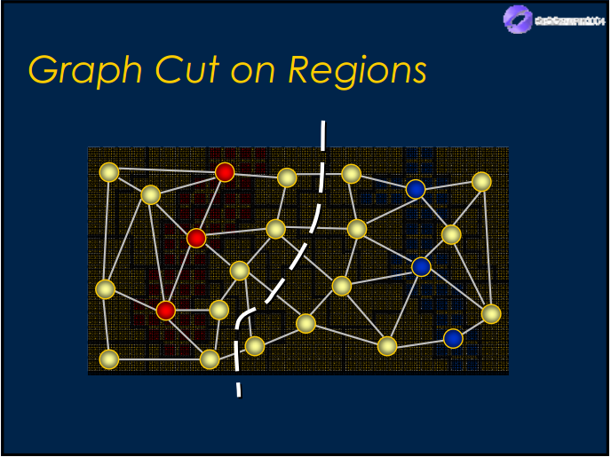
Step 4: Graph cut and final segmentation

Slide 49
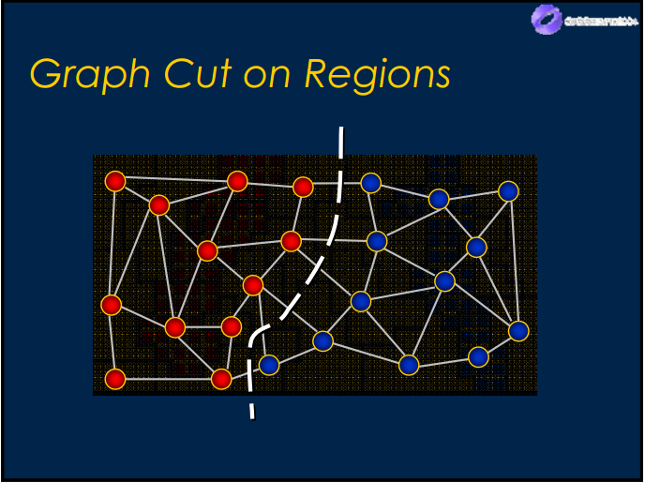
Final segmentation
We apply Graph Cut solution of Yuri Boykov and Vladimir Kolmogorov to the network to solve maximum flow problem.

Slide 50
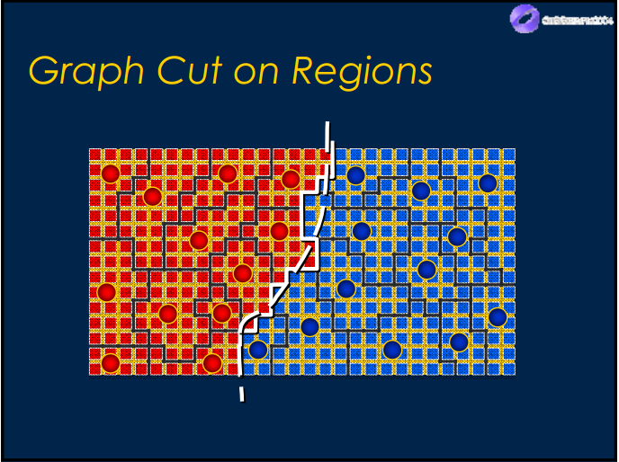
Final segmentation
We transfer label value of vertices back to all regions in the original image, change color or background regions to get final segmentation – object selection.

Slide 51

Sample result

Slide 52
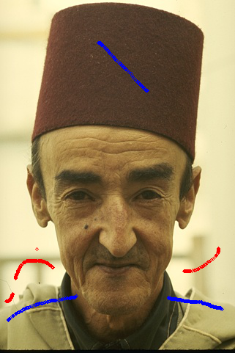

Limitation 1: Pixel loss in thin area
189080 with samples
Final segmentation

Slide 53
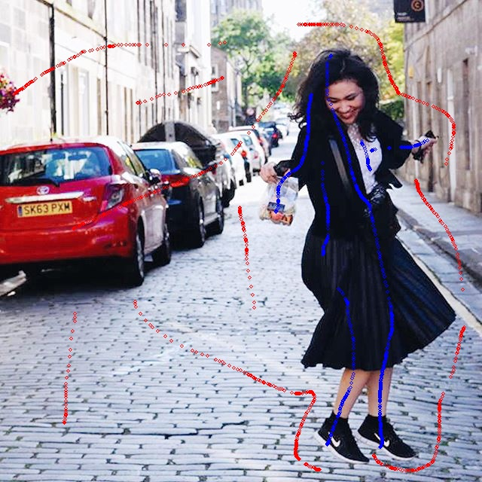
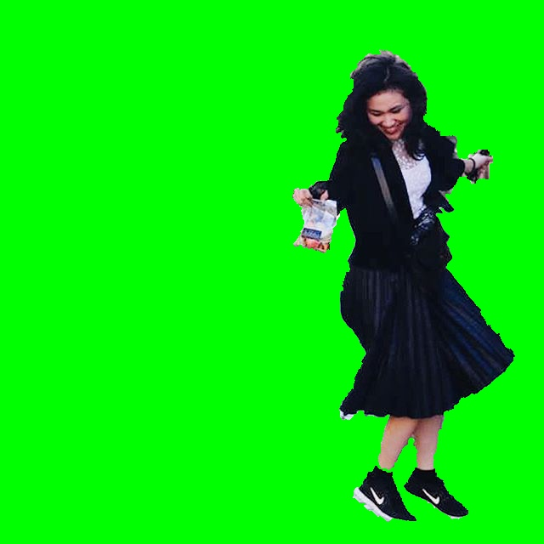
Limitation 2: Unsmooth boundary
Dancing_Emily with samples
Final segmentation

Slide 54
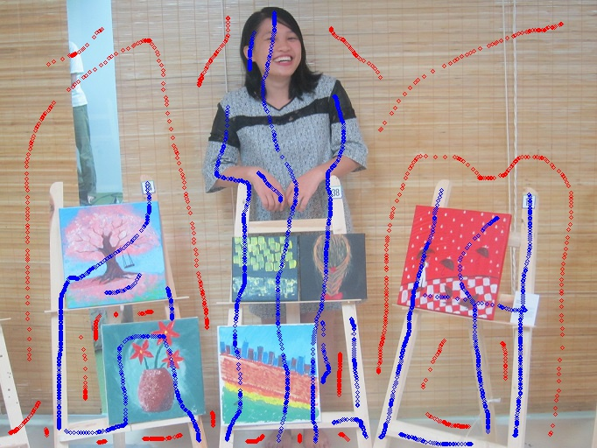
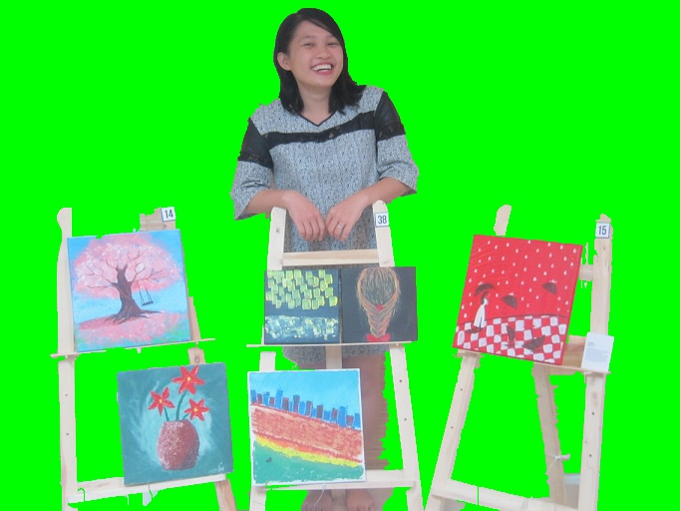
Limitation 3: Poor performance when foreground and background have similar color distribution
Vango with samples
Final segmentation

Slide 55
Introduction
Literature review
Problem statement
Interactive graph cut segmentation
Silent Lazy Snapping solution
Experimental results
Future direction
Question and answer

Slide 56
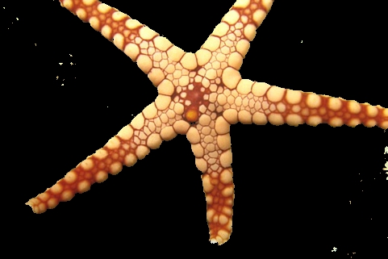

Berkeley dataset – 12003.jpg
Interactive Graph Cut
Silent Lazy Snapping

Slide 57

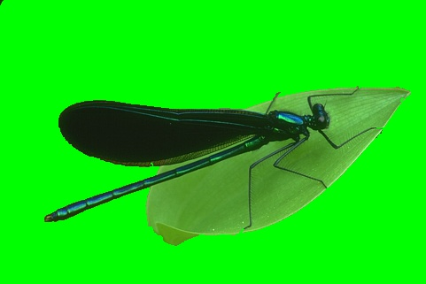
Berkeley dataset – 35070.jpg
Interactive Graph Cut
Silent Lazy Snapping

Slide 58


Berkeley dataset – 176035.jpg
Interactive Graph Cut
Silent Lazy Snapping

Slide 59


Berkeley dataset – 187029.jpg
Interactive Graph Cut
Silent Lazy Snapping

Slide 60
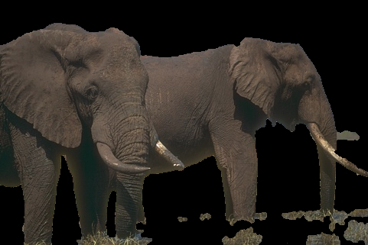
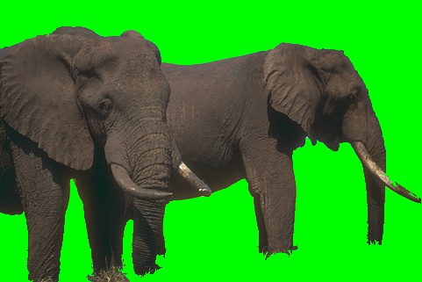
Berkeley dataset – 207056.jpg
Interactive Graph Cut
Silent Lazy Snapping

Slide 61
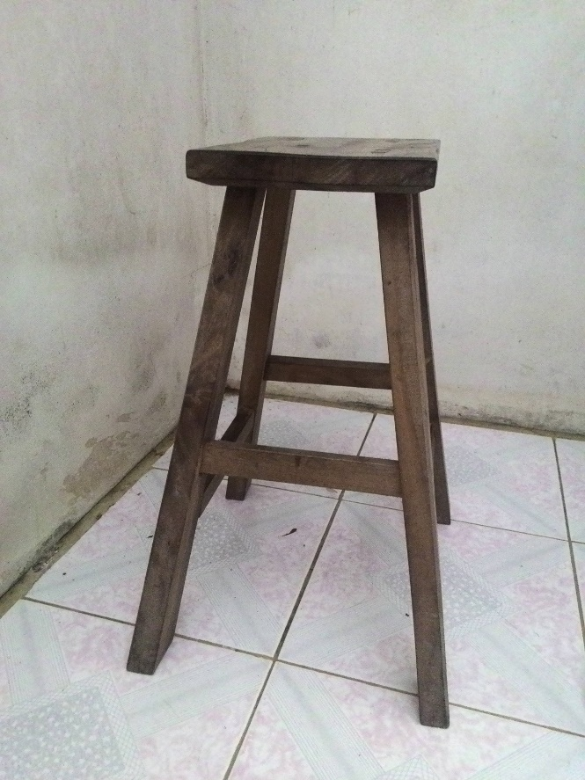
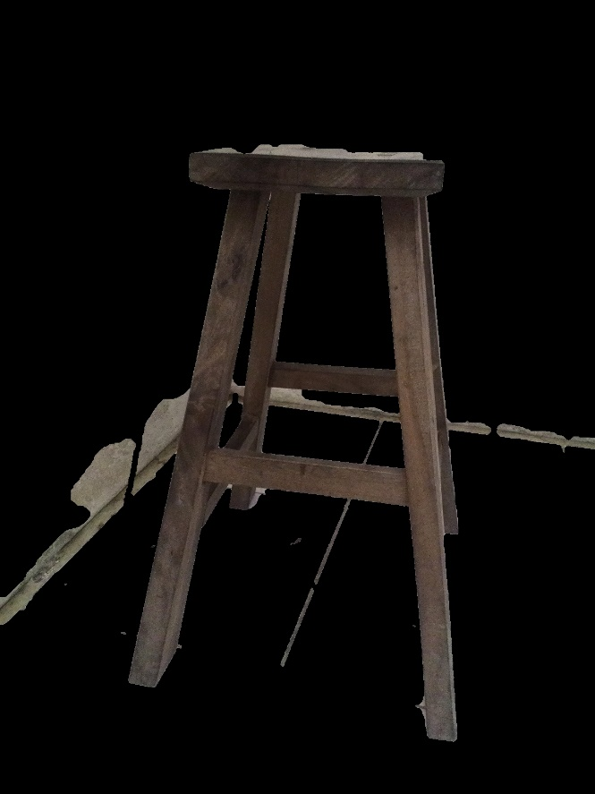
Khoi’s dataset – 5.jpg
Original Image
Interactive Graph Cut

Slide 62

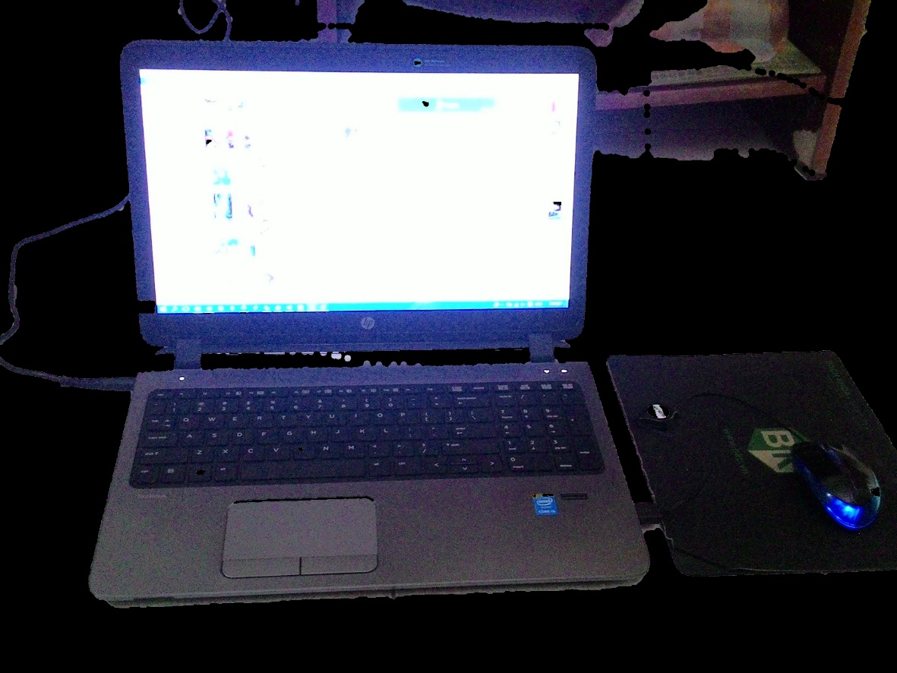
Khoi’s dataset – 6.jpg
Original Image
Interactive Graph Cut

Slide 63
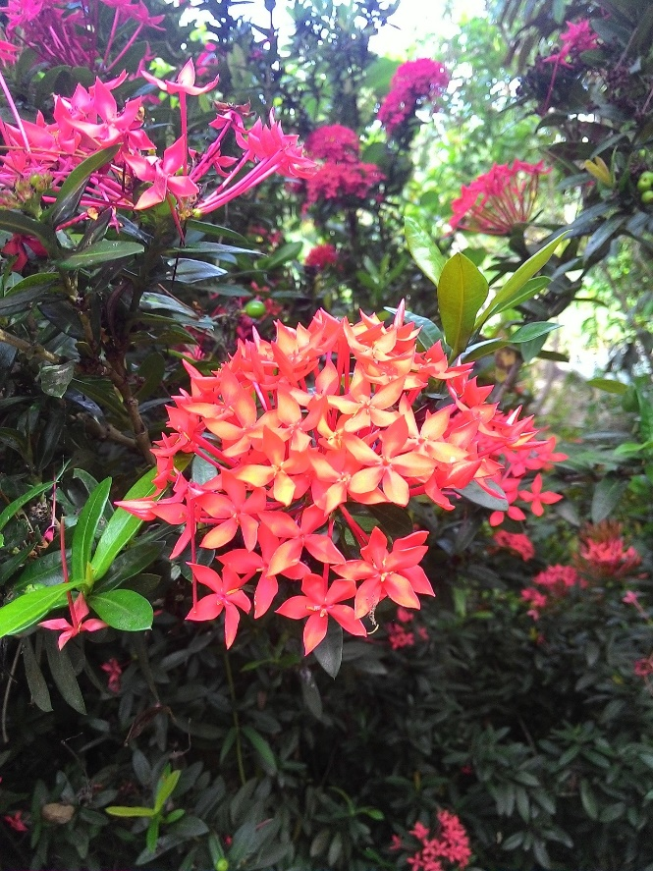

Khoi’s dataset – 7.jpg
Original Image
Interactive Graph Cut

Slide 64
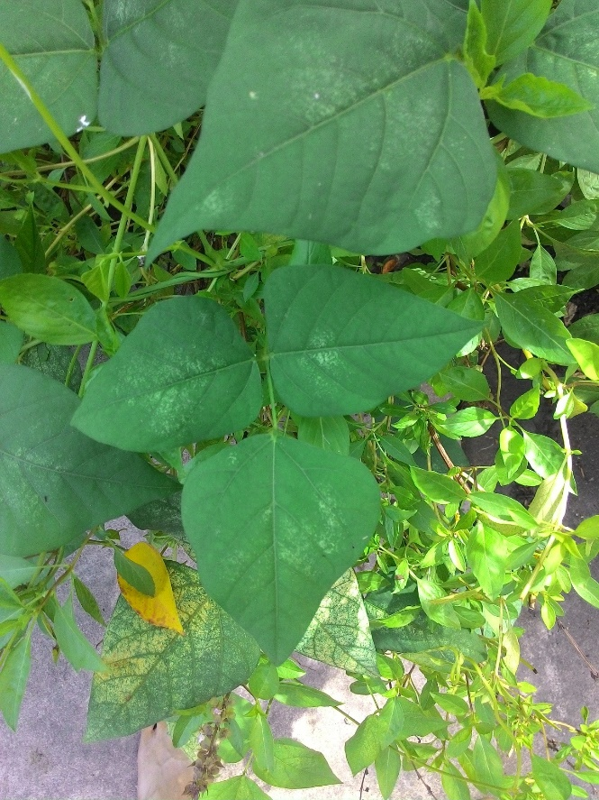

Khoi’s dataset – 8.jpg
Original Image
Interactive Graph Cut

Slide 65
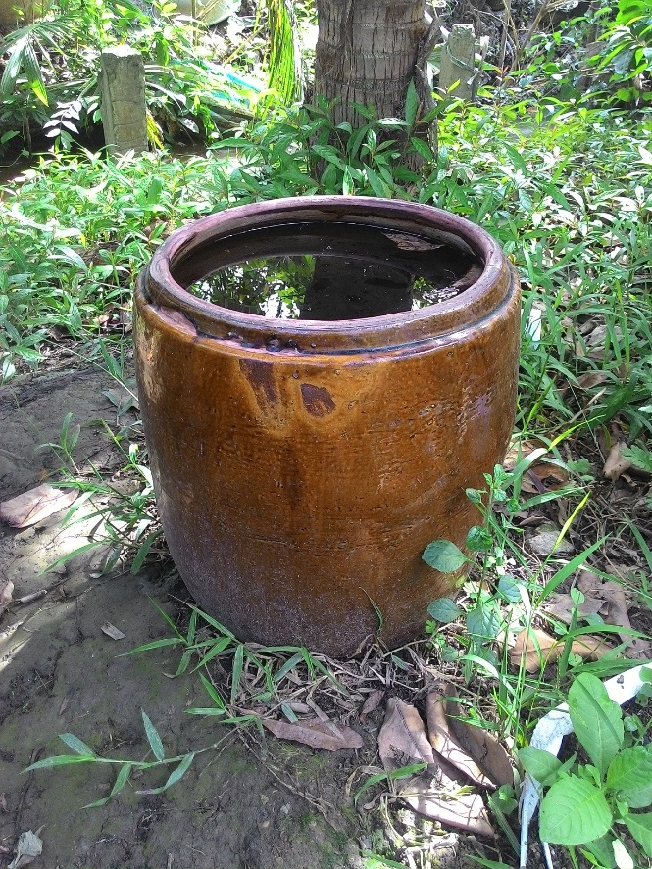
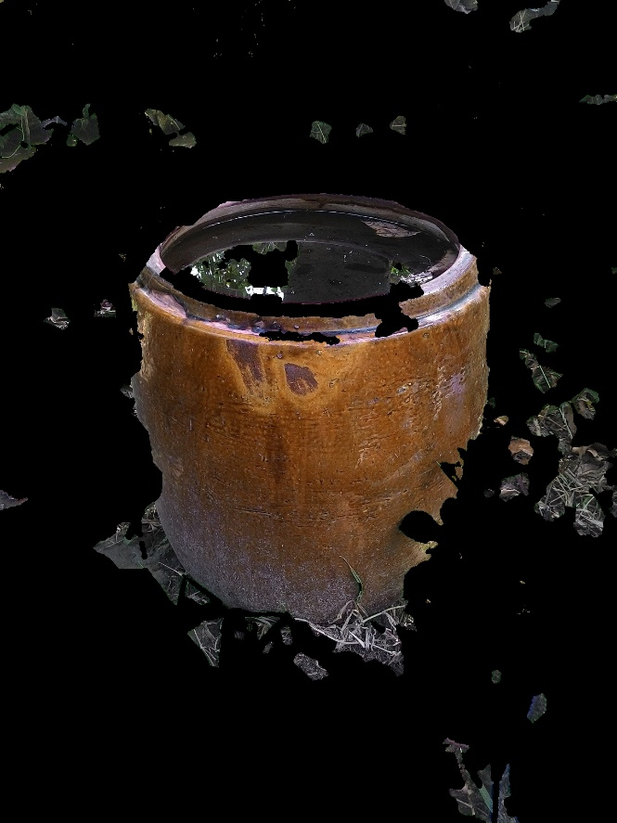
Khoi’s dataset – 9.jpg
Original Image
Interactive Graph Cut

Slide 66


Nam’s dataset – Cat.jpg
Original Image
Silent Lazy Snapping

Slide 67


Nam’s dataset – TrangAn.jpg
Original Image
Silent Lazy Snapping

Slide 68

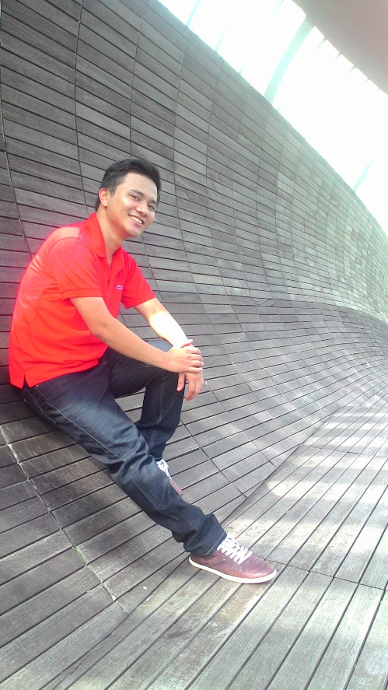
Nam’s dataset – Nam_2.jpg
Original Image
Silent Lazy Snapping

Slide 69

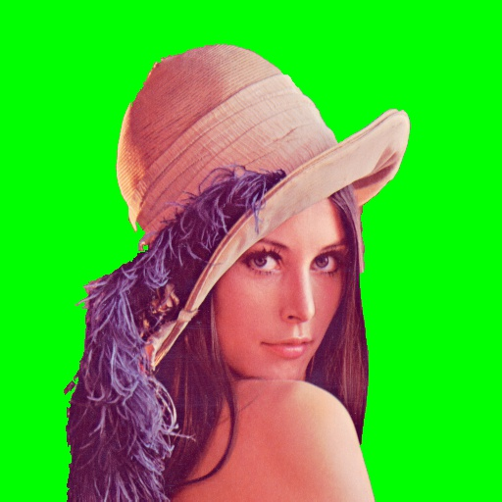
Nam’s dataset – WSpaper.jpg
Original Image
Silent Lazy Snapping

Slide 70


Nam’s dataset – Emily_child.jpg
Original Image
Silent Lazy Snapping

Slide 71
Introduction
Literature review
Problem statement
Interactive graph cut segmentation
Silent Lazy Snapping solution
Experimental results
Future direction
Question and answer

Slide 72
Introduction
Literature review
Problem statement
Interactive graph cut segmentation
Silent Lazy Snapping solution
Experimental results
Future direction
Question and answer

Slide 73
THANK YOU FOR LISTENING!

